Slide 1

Optimize cost and improve scalability with Karpenter on Kubernetes
Kubecon north America 2023
Sandhya Job
Rodrigo Bersa
WW Senior Container Specialist
Amazon Web Services
WW Senior Container Specialist SA
Amazon Web Services

Slide 2

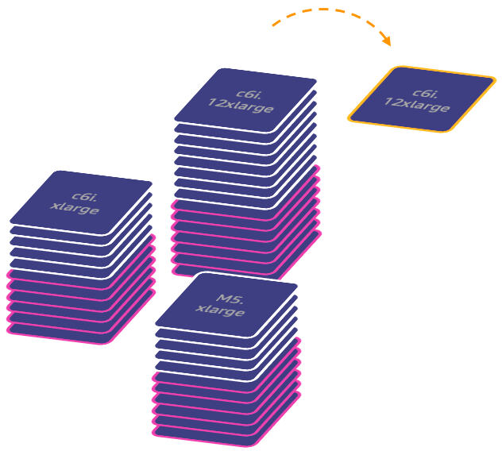
Right sized scaling
Karpenter is open-source, flexible, and high-performance Kubernetes cluster autoscaler that simplifies infrastructure with the right nodes at the right time.
Application first infrastructure
Node provisioning based on Pod requirements, improving application availability by responding faster
Simplified Configuration
Minimizes operational overhead with opinionated defaults and Kubernetes-native CRDs in a single configuration
Diversify with Spot and On-Demand
Karpenter helps simplify diversification across purchase options and instance types
Automated Node consolidation
Lowers costs by constantly looking for ways to improve efficiency on right sized compute
Notes:
Like CAS, Karpenter is an open source project, created initially by AWS and donated to the community.
Karpenter simplifies Kubernetes infrastructure with the right nodes at the right time (or just in time).
Karpenter provides an application first infrastructure by provisioning nodes based on pod requirements
Karpenter uses Kubernetes native concepts with a single configuration to support a variety of compute instance types, including Spot, On-Demand, x86 and ARM from a single configuration
It also enables support for diversification across purchasing options with Spot and on-demand
Karpenter is fully supported by AWS, launched for GA in 2021

Slide 3
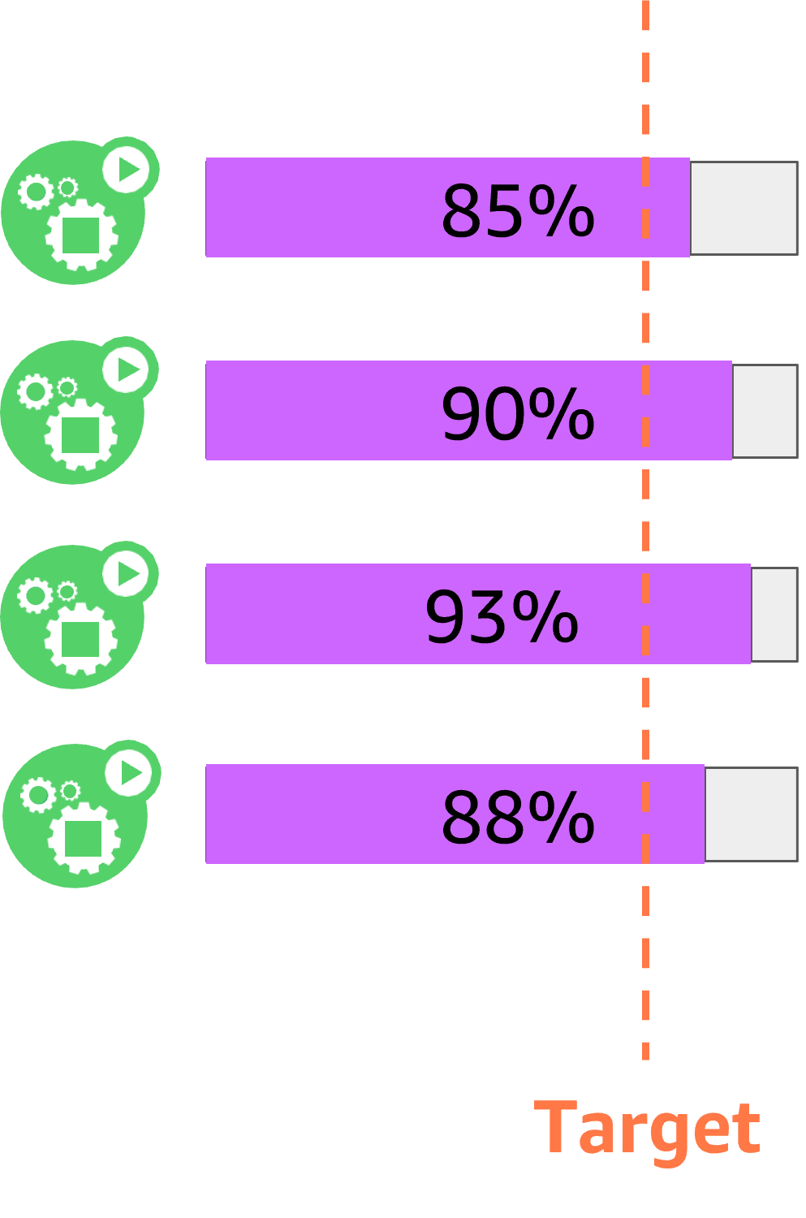
Karpenter Scale-Out
HPA >> Pending pods
Kubernetes
Default: all standard instance types
x sec
OR
New node
Instance Families:
[m5, m5a, m6i, …]
Provisioning and scheduling decisions
Works with kube-scheduler to provision the right set of nodes
Supports all scheduling constraints: Topology Spread, Node/Pod Affinity and Anti-Affinity, etc
Node
1 vCPU request

Slide 4
Karpenter Scale-In
HPA << Pending pods
Karpenter
Consolidation actively seeks out opportunities to make the cluster more cost efficient
Terminations
Replace underutilized nodes with more efficient compute
Node Expiration TTL
kubectl delete node with graceful draining
Node
1 vCPU request

Slide 5
Benefits of leveraging Karpenter
Node consolidation
Operational efficiency
Cost Optimization
Application Availability
Node auto-provisioning
Simplified Resource management
Rapid scaling
Compute availability
Optimal Compute Infrastructure E.g. Intel, Graviton, GPUs
Flexibility E.g. No need to configure every node group)
Increases utilization E.g. Consolidates and bin packs pods to fewer node groups
Lowers costs E.g. consolidation from On-Demand->On-Demand, On-Demand->EC2 Spot
Faster E.g. responds quickly and automatically to changes in application load, scheduling, and resource requirements
Easy upgrades
Efficient management E.g. many clusters and node groups
Mixes purchasing options as needed E.g. Prioritizes Spot, pulls in On-Demand if Spot is not available
Notes:
Amazon EC2 offers four different purchasing options to provision compute: *Click*
On-Demand: You provision instances when you need them. *Click*. Pay-as-you-go, pay by the second, no up front commitments, this is where most customers start their cloud journey. When comparing with other purchase options it’s almost like our premium purchase option, and its great for short-term usage.
*Click*
Reserved Instance: *Click* - Is ideal for customers who know exactly what they are going to run over a duration, and offers big savings for a 1 or 3 year commitment. Best for always on workloads
Savings Plans: Just like RI’s, but rather than making commitments to specific instance configuration, you can save money just by committing to a dollar spend. Super flexible and allow you to change that usage from one region to another, or from instance type to another, or even if you move from EC2 to Fargate, the savings plan moves with you.
*Click*
Spot Instances: Is making use of AWS’ spare capacity to provision instances at a highly discounted rate. *Click* Same as pay-as-you-go pricing as On-Demand, but at up to 90% off. Best for stateless, flexible, and fault tolerant workloads. The caveat with this discount and spare-capacity is that EC2 can reclaim that instance with proactive/reactive (2 minute) warning.
Efficienct management large EKS environment with many clusters and nodes at scale through upgrades
Consolidates and bin packs pods to fewer node groups to increase utilization. Chooses the lowest priced instances for OD. It does consolidation from OD->OD, OD->Spot.
Karpenter responds quickly and automatically to changes in application load, scheduling, and resource requirements, placing new workloads onto a variety of available compute resource capacity.
Ensures compute availability
With mixing purchasing options with Spot and OD, RIs.

Slide 6


How Karpenter works
HPA / VPA
Pending pods
EC2 Fleet (instant)
CA
ASG
Consolidates instance orchestration responsibilities within a single system

Slide 7












Compute flexibility with Karpenter
EKS Cluster
Karpenter Provisioner
AZ 1
AZ 2
AZ 3
P4
g5
g4
Notes:
Karpenter provides great flexibility in compute provisioning on different dimensions (instance types, sizes, purchase options, cpu architectures, gpu accelerated, availability zones). Karpenter achieves this without Autoscaling Groups. Karpenter is also a good example of how EC2 Fleet “Instant” mode can be used for just-in time compute provisioning and scaling

Slide 8

























Infrastructure layout
AWS Cloud
Availability Zone 1
Availability Zone 2
Availability Zone 3
VPC
Amazon Elastic Kubernetes Service (Amazon EKS)
Fargate
Profiles
kube-system
karpenter
Karpenter
default
cost-optimization
gpu

Slide 9



Kubernetes layout
AWS Cloud
Amazon EKS
Fargate Profiles
kube-system
karpenter
Karpenter
default
gpu-operator
kubecost
cost-optimization
default
inflate
gpu
gpu

Slide 10
“Demo”

Slide 11
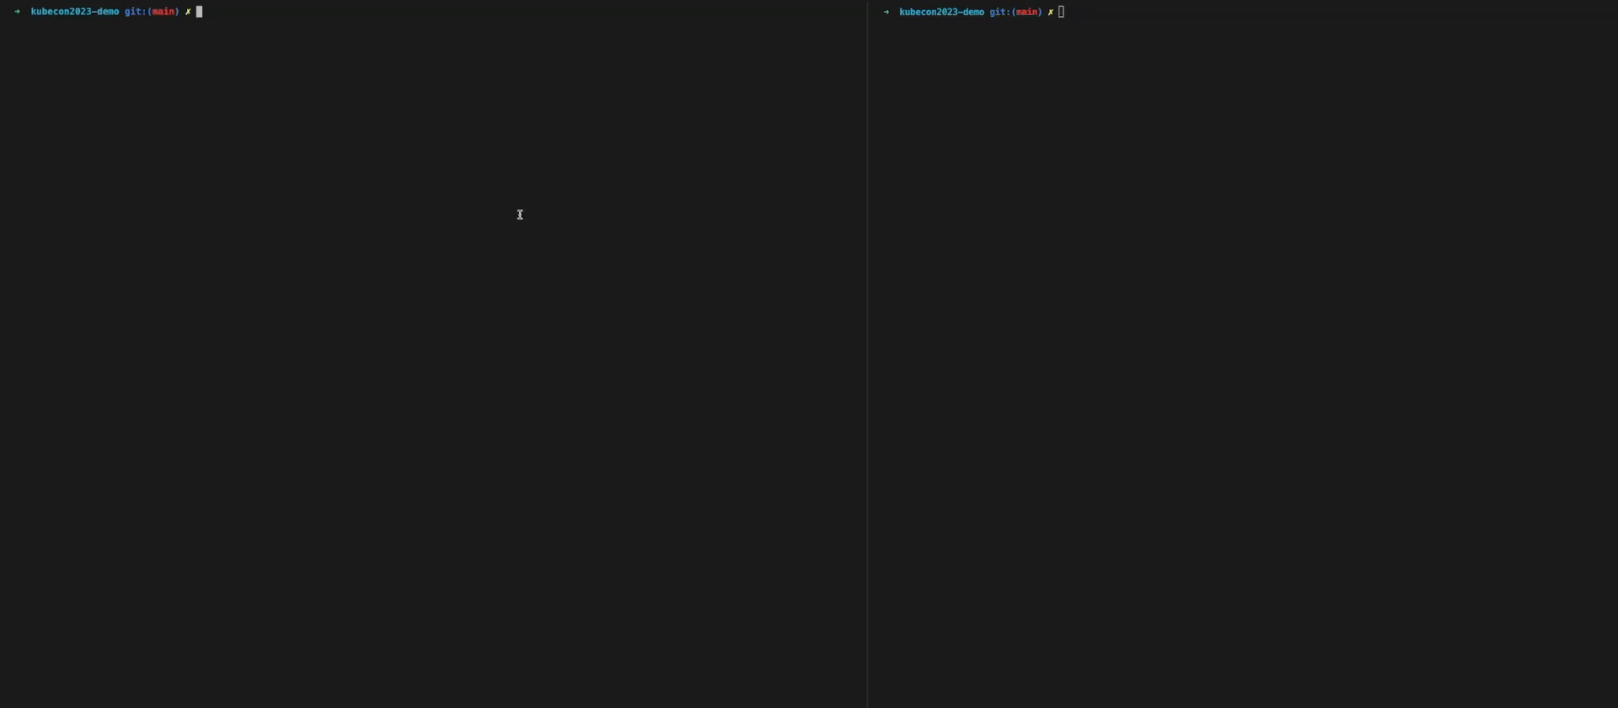

Slide 12


Session resources
https://github.com/rodrigobersa/public-resources
https://github.com/aws-samples/karpenter-blueprints

Slide 13
Sandhya Job
Rodrigo Bersa
sandyjob@amazon.com
bersr@amazon.com
linkedin.com/in/bersa

